Slide 1

Machine translation
Md shahidul salim ,lecturer, cse, kuet

Slide 2
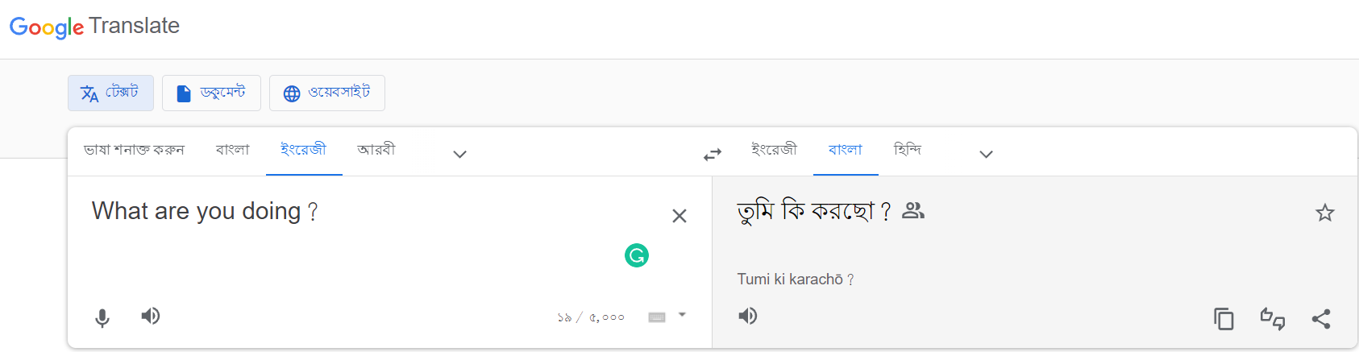
The most common current use of machine translation is for information access.
Translate some instructions on the web, perhaps the recipe for a favorite dish, or the steps for putting together some furniture.
Computer-aided translation-produce a draft translation that is fixed up in a post-editing phase by a human translator.
Translating speech on-the-fly before the entire sentence is complete
Image-centric translation can be used for example to use OCR of the text

Slide 3
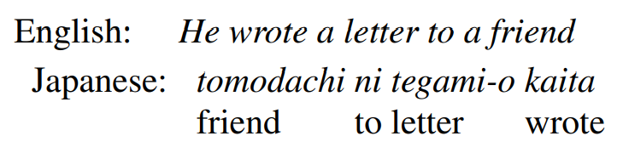
encoder-decoder
The standard algorithm for MT is the encoder-decoder network, also called the sequence to sequence network, an architecture that can be implemented with RNNs or with Transformers.
RNN or Transformer architecture can be used to do classification or sequence labeling (for example to assign each word in an input sentence with a part-of-speech, or with a named entity tag)
The output sequence is a complex function of the entire input sequencer;
The words of the target language don’t necessarily agree with the words of the source language in number or order.
Note that the elements of the sentences are in very different places in the different languages. In English, the verb is in the middle of the sentence, while in Japanese, the verb kaita comes at the end. The Japanese sentence doesn’t require the pronoun he, while English does

Slide 4
encoder-decoder
Encoder-decoder networks are very successful at handling these sorts of complicated cases of sequence mappings.
Indeed, the encoder-decoder algorithm is not just for MT; it’s the state of the art for many other tasks where complex mappings between two sequences are involved.
Summarization,
Classification
Text generation

Slide 5
Language Divergences and Typology
Some aspects of human language seem to be universal holding true for every language, or are statistical universals, holding true for most languages.
Every language, for example, seems to have words for referring to people, for talking about eating and drinking, for being polite or not.
There are also structural linguistic universals; for example, every language seems to have nouns and verbs.
Has ways to ask questions, or issue commands, linguistic mechanisms for indicating agreement or disagreement.

Slide 6
Translation divergence
Yet languages also differ in many ways, and an understanding of what causes such translation divergences will help us build better MT models.
Distinguish the idiosyncratic and lexical differences.
Systematic differences that we can model in a general way (many languages put the verb before the direct object; others put the verb after the direct object).
The study of these systematic cross-linguistic similarities and differences is called linguistic typology.

Slide 7
Word Order Typology
Languages differ in the basic word order of verbs, subjects, and objects in simple declarative clauses.
German, French, English, and Mandarin, for example, are all SVO (Subject-Verb-Object) languages, meaning that the verb tends to come between SOV the subject and object.
Hindi and Japanese, by contrast, are SOV languages, meaning that the verb tends to come at the end of basic clauses.
and Irish and Arabic are VSO languages. Two languages that share their basic word order type often have other similarities.
All of these word order differences between languages can cause problems for translation, requiring the system to do huge structural reorderings as it generates the output.

Slide 8
Lexical Divergences
For any translation, the appropriate word can vary depending on the context.
The English source-language word bass, for example, can appear in Spanish as the fish lubina or the musical instrument bajo.
German uses two distinct words for what in English would be called a wall: Wand for walls inside a building, and Mauer for walls outside a building.
Where English uses the word brother for any male sibling, Chinese and many other languages have distinct words for older brother and younger brother (Mandarin gege and didi, respectively).
In all these cases, translating bass, wall, or brother from English would require a kind of specialization, disambiguating the different uses of a word.
For this reason the fields of MT and Word Sense Disambiguation are closely linked.

Slide 9
Referential density
Languages vary along a typological dimension related to the things they tend to omit
Some languages, like English, require that we use an explicit pronoun when talking about a referent that is given in the discourse. In other languages, however, we can sometimes omit pronouns altogether (Ex: Spanish)
Languages that can omit pronouns are called pro-drop languages.
Japanese and Chinese, for example, tend to omit far more than does Spanish. This dimension of variation across languages is called the dimension of referential density.

Slide 10
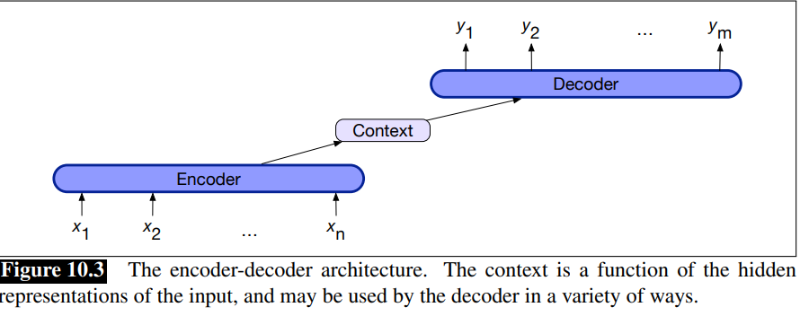
The Encoder-Decoder Model
Google Translate started using such a model in production in late 2016.
Generating contextually appropriate, arbitrary length, output sequences.
Applications including machine translation, summarization, question answering, and dialogue
Encoder network that takes an input sequence and creates a contextualized representation of it, often called the context.
This representation is then passed to a decoder which generates a task specific output sequence.

Slide 11
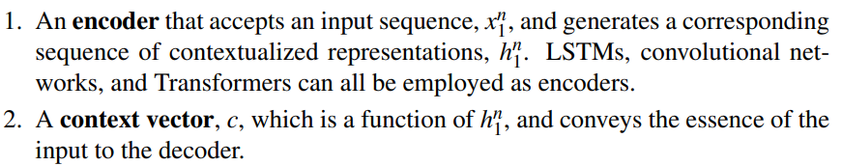
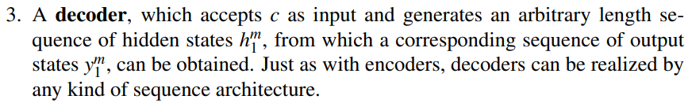
Components of Encoder-decoder

Slide 12
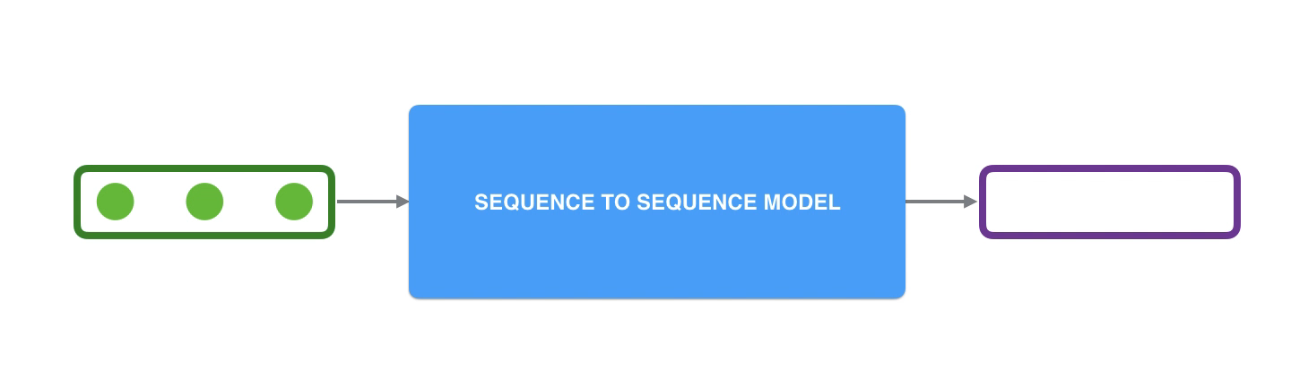
sequence-to-sequence model
A sequence-to-sequence model is a model that takes a sequence of items (words, letters, features of an images…etc) and outputs another sequence of items. A trained model would work like this:

Slide 13
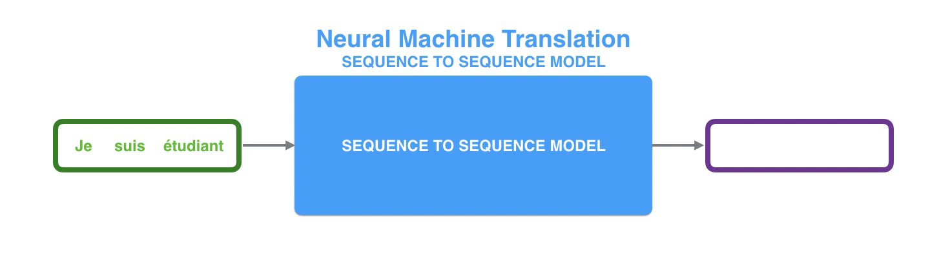
In neural machine translation, a sequence is a series of words, processed one after another. The output is, likewise, a series of words:

Slide 14
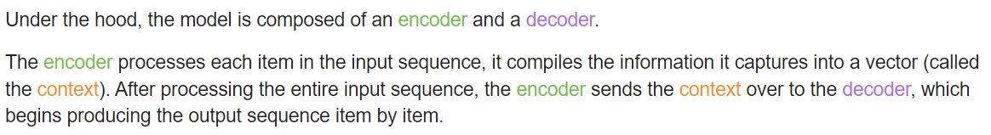
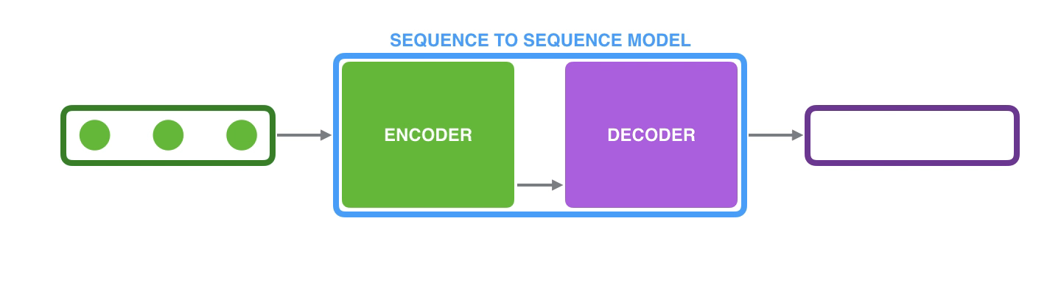
Looking under the hood

Slide 15
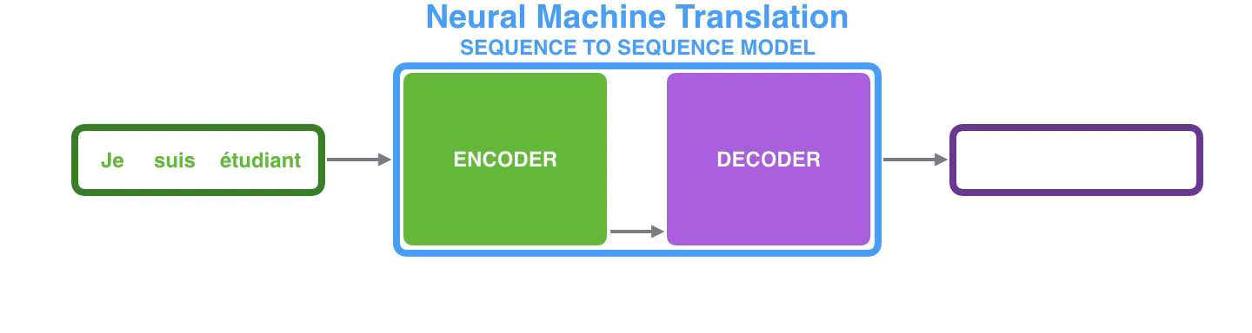
The same applies in the case of machine translation.

Slide 16
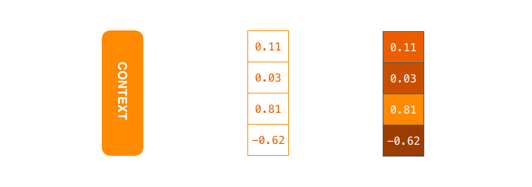
The context is a vector (an array of numbers, basically) in the case of machine translation. The encoder and decoder tend to both be recurrent neural networks
https://www.youtube.com/watch?v=UNmqTiOnRfg

Slide 17
Set the size of the context vector when set up model
The number of hidden units in the encoder RNN
These visualizations show a vector of size 4, but in real world applications the context vector would be of a size like 256, 512, or 1024.

Slide 18
A RNN takes two inputs at each time step
An input (in the case of the encoder, one word from the input sentence), and a hidden state
The word, however, needs to be represented by a vector.
To transform a word into a vector, we turn to the class of methods called “word embedding” algorithms.
These turn words into vector spaces that capture a lot of the meaning/semantic information of the words (e.g. king - man + woman = queen).

Slide 19
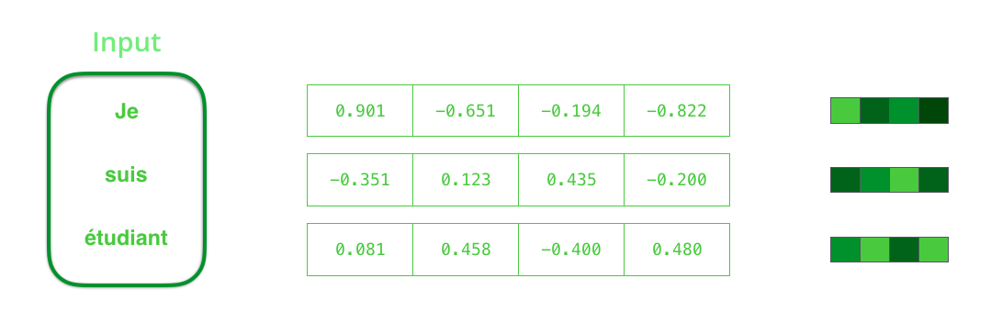
We need to turn the input words into vectors before processing them. That transformation is done using a word embedding algorithm. We can use pre-trained embeddings or train our own embedding on our dataset. Embedding vectors of size 200 or 300 are typical, we're showing a vector of size four for simplicity.

Slide 20
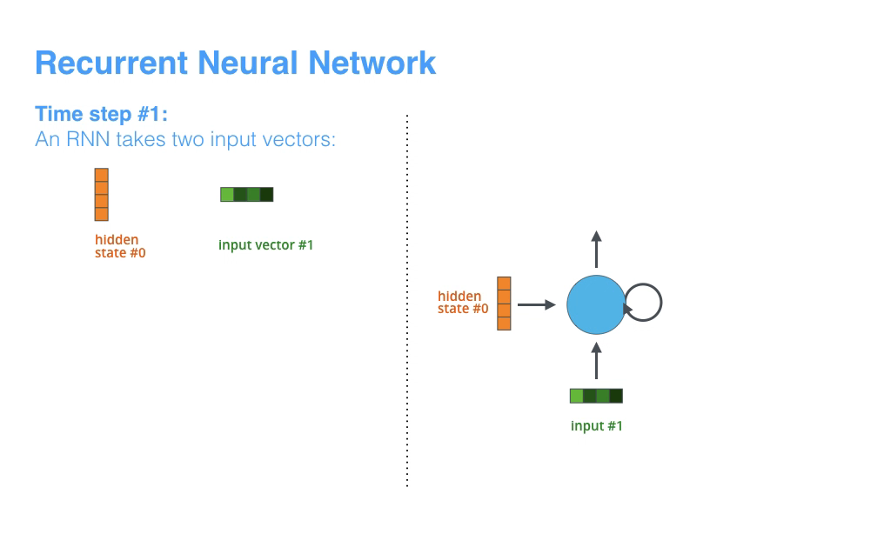
mechanics of an RNN
The next RNN step takes the second input vector and hidden state #1 to create the output of that time step. each pulse for the encoder or decoder is that RNN processing its inputs and generating an output for that time step. Since the encoder and decoder are both RNNs, each time step one of the RNNs does some processing, it updates its hidden state based on its inputs and previous inputs it has seen.

Slide 21
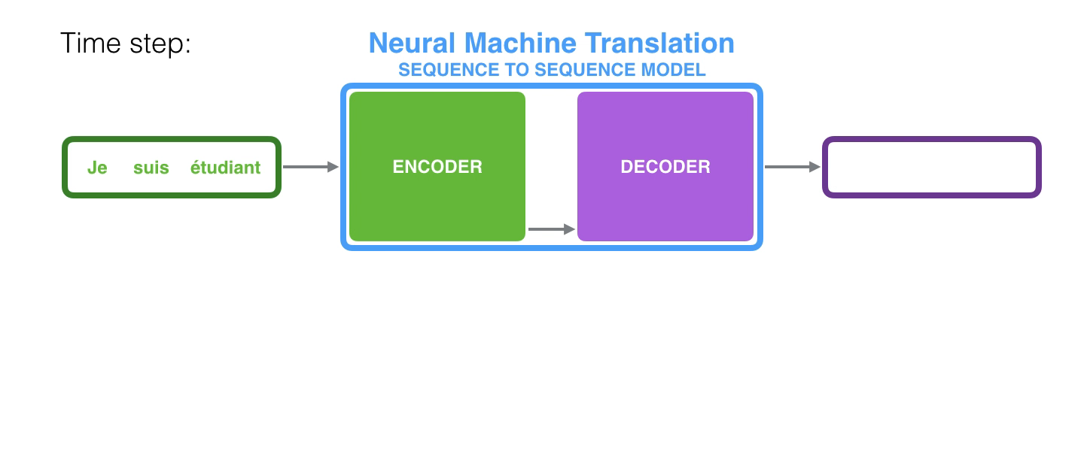
Let’s look at the hidden states for the encoder. Notice how the last hidden state is actually the context we pass along to the decoder.

Slide 22
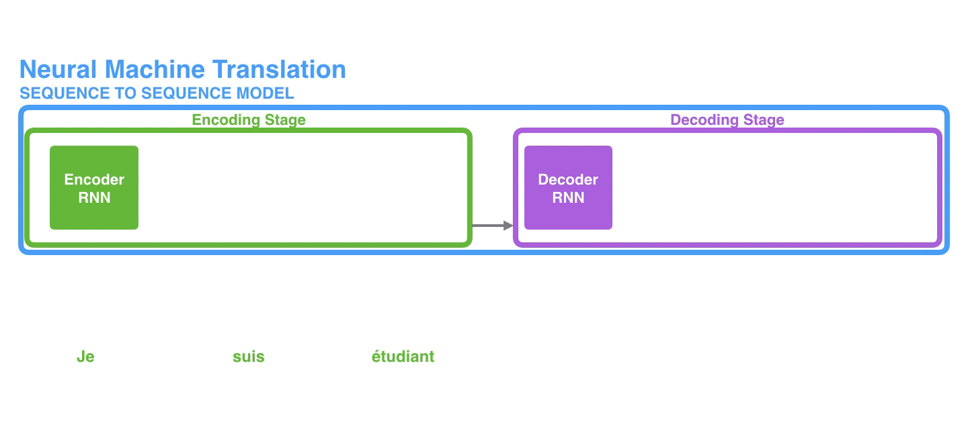
“unrolled” view where instead of showing the one decoder, we show a copy of it for each time step. This way we can look at the inputs and outputs of each time step.

Slide 23
The context vector turned out to be a bottleneck for these types of models. It made it challenging for the models to deal with long sentences. A solution was proposed in Bahdanau et al., 2014 and Luong et al., 2015. These papers introduced and refined a technique called “Attention”, which highly improved the quality of machine translation systems. Attention allows the model to focus on the relevant parts of the input sequence as needed.

Slide 24
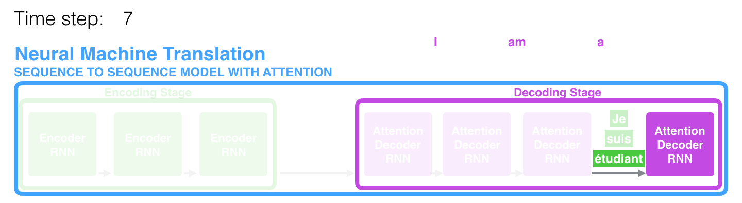
At time step 7, the attention mechanism enables the decoder to focus on the word "étudiant" ("student" in french) before it generates the English translation. This ability to amplify the signal from the relevant part of the input sequence makes attention models produce better results than models without attention.

Slide 25
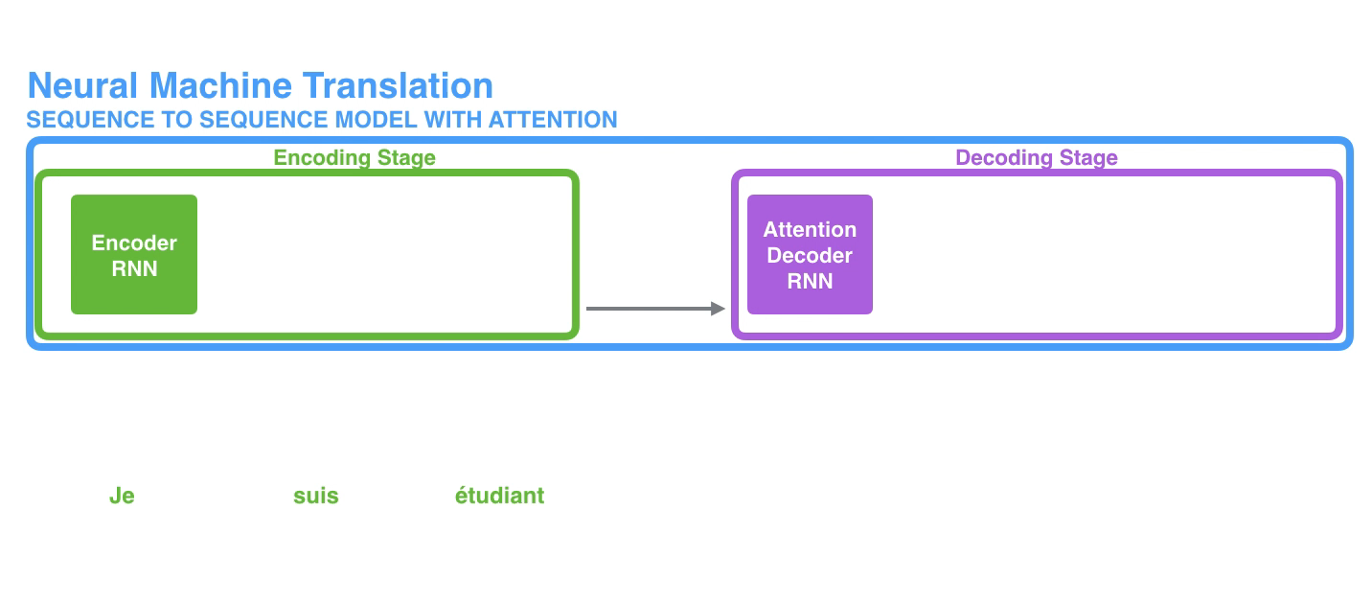
attention models at this high level of abstraction
First, the encoder passes a lot more data to the decoder. Instead of passing the last hidden state of the encoding stage, the encoder passes all the hidden states to the decoder:

Slide 26
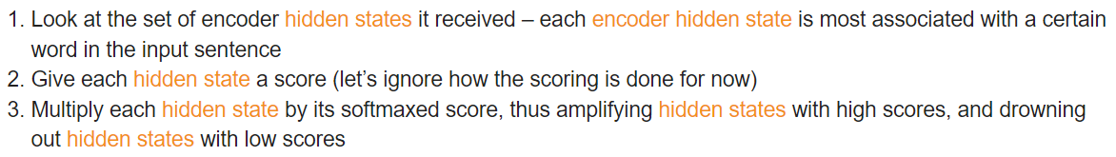
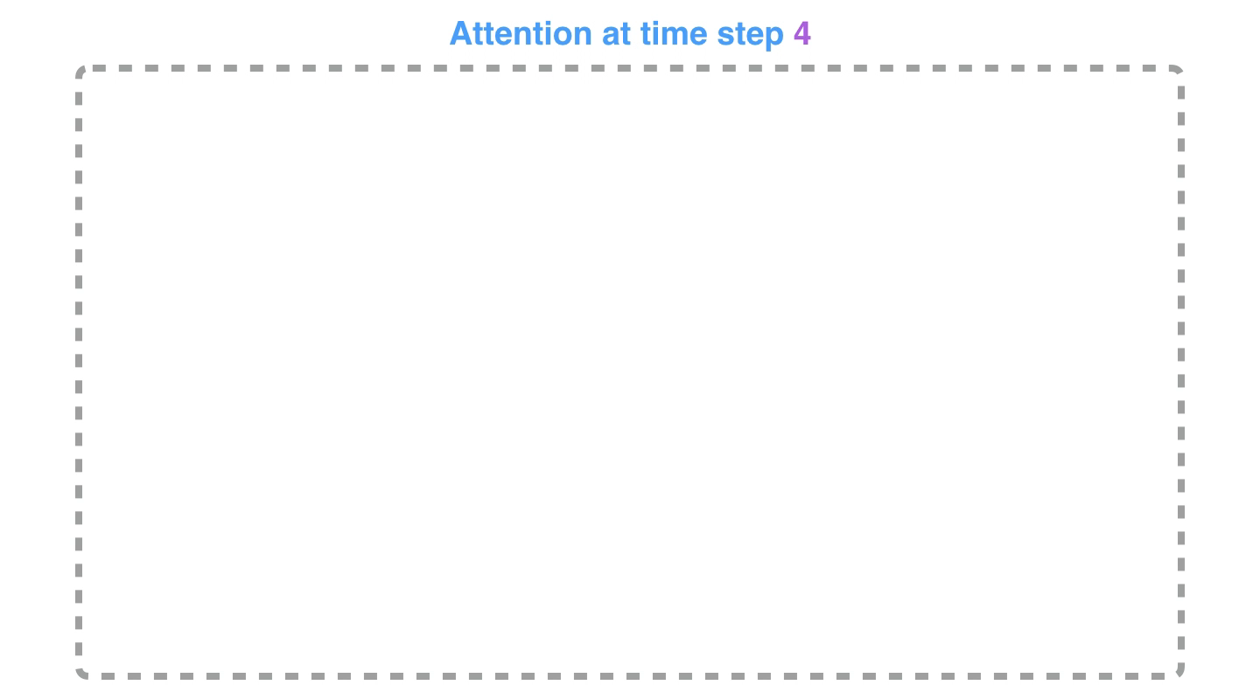
Second, an attention decoder does an extra step before producing its output. In order to focus on the parts of the input that are relevant to this decoding time step, the decoder does the following:

Slide 27
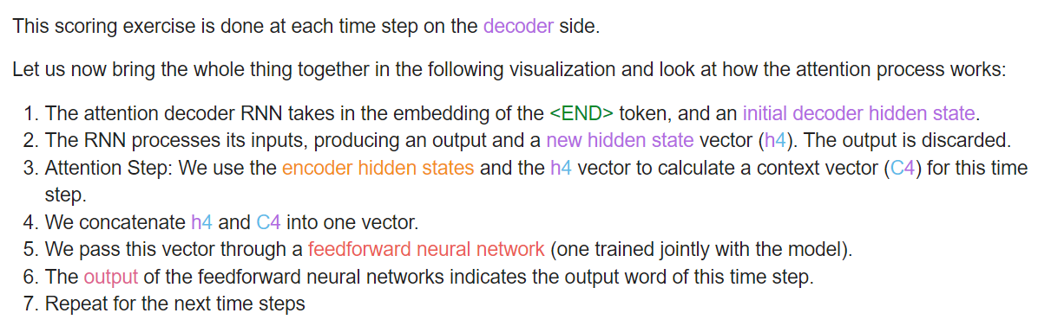

Slide 28
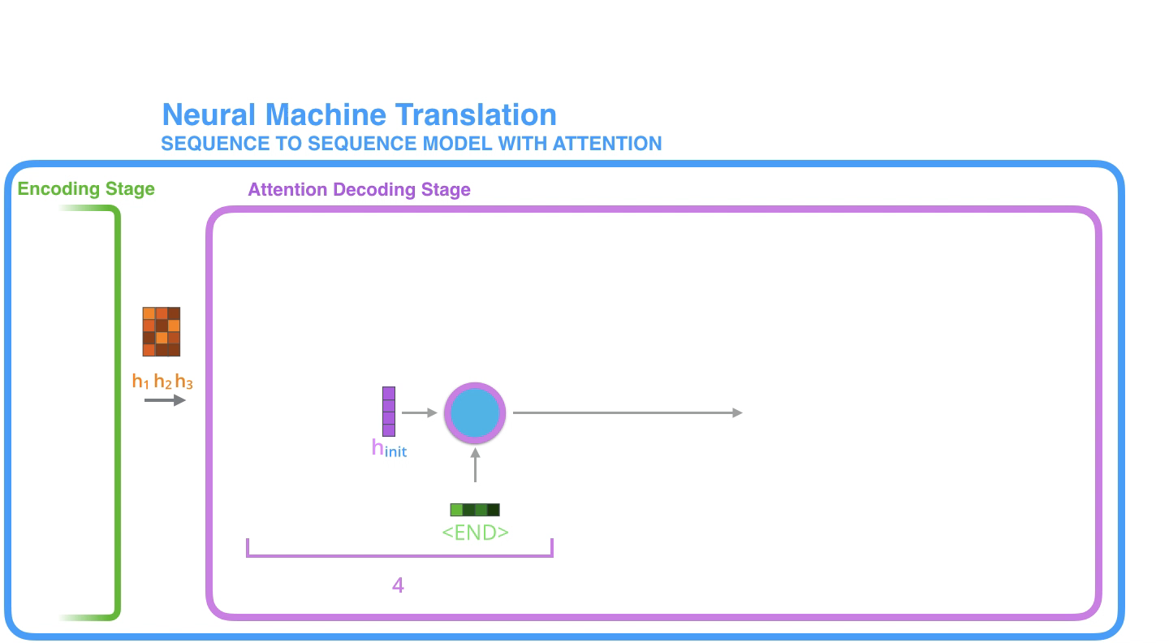

Slide 29
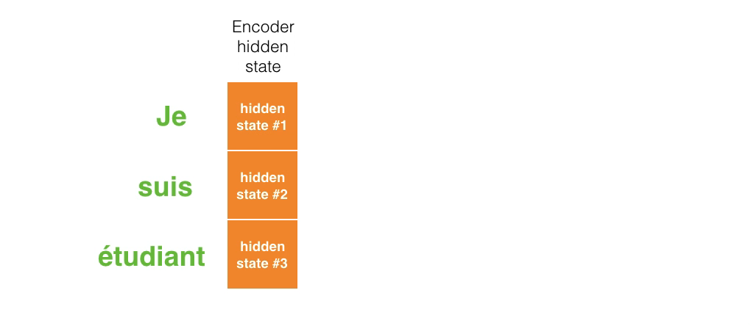
This is another way to look at which part of the input sentence we’re paying attention to at each decoding step:

Slide 30
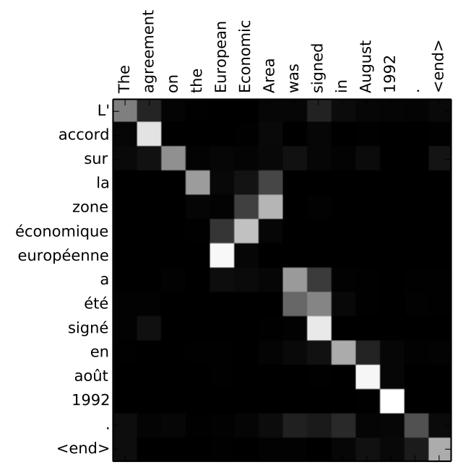
Note that the model isn’t just mindless aligning the first word at the output with the first word from the input. It actually learned from the training phase how to align words in that language pair (French and English in our example). An example for how precise this mechanism can be comes from the attention papers listed above:
You can see how the model paid attention correctly when outputing "European Economic Area". In French, the order of these words is reversed ("européenne économique zone") as compared to English. Every other word in the sentence is in similar order.

Slide 31
Reference
https://github.com/tensorflow/nmt
https://jalammar.github.io/visualizing-neural-machine-translation-mechanics-of-seq2seq-models-with-attention/

